Slide 1

RansomwareBitcoin Addresses
Stephen Lewis
Notes:
1. Table of contents
2. Introduction
3. Our company
4. Our team
5. Problem
6. Them vs. us
7. Solution
8. SWOT analysis
9. Product overview
10. Our plans
11. Product demo
12. Traction
13. Case study
14. Reviews
15. Awards
16. Market size
17. Target
18. Competitors
19. Business model
20. Timing
21. Predicted growth
22. Investment

Slide 2

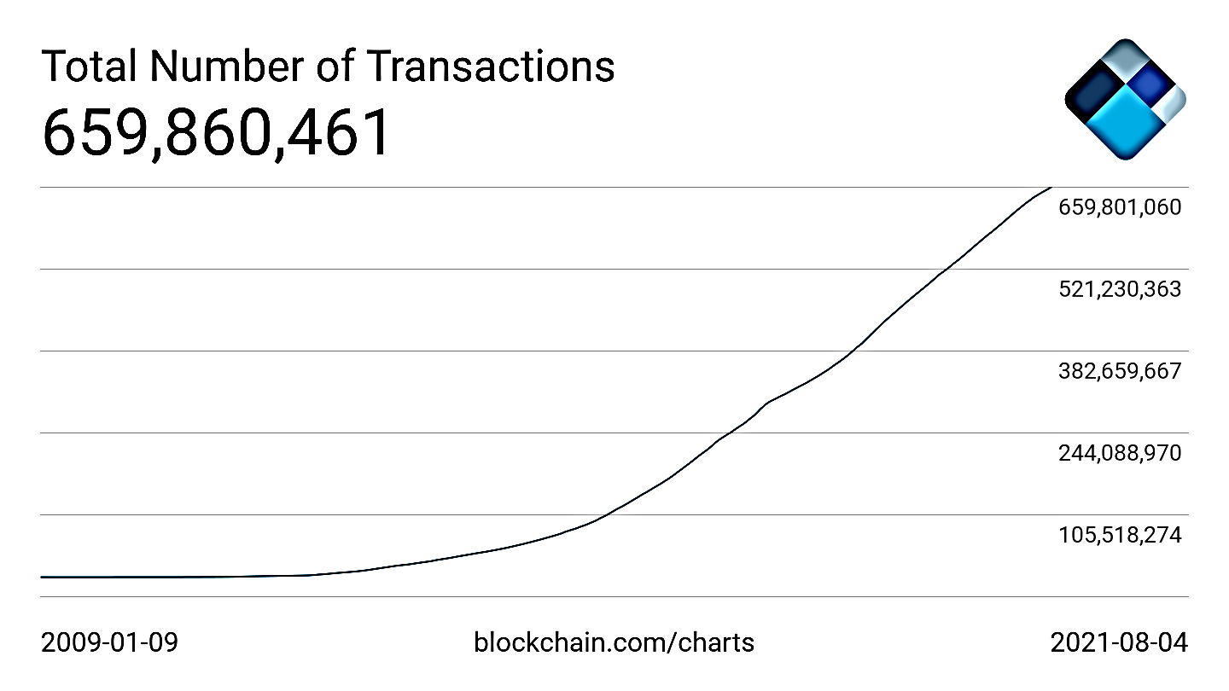
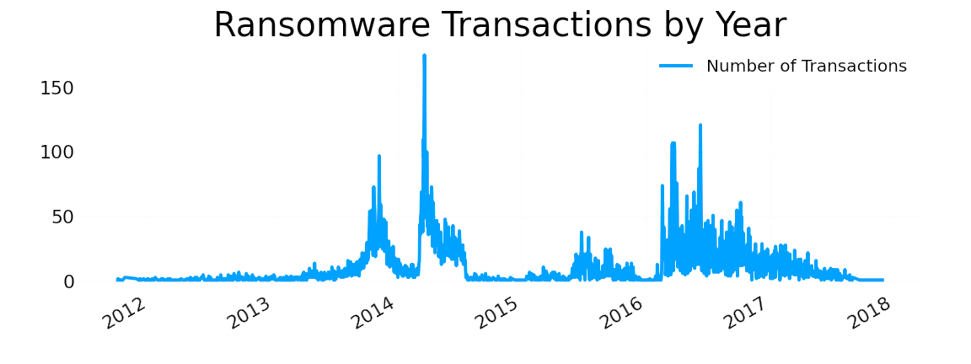
BACKGROUND
Bitcoin transactions have risen steadily since its inception in 2008.
In 2013, the rise of the CryptoLocker virus sparked a surge in ransomware attacks.
Recent high-profile BTC ransomware attacks have drawn the attention of regulators.

Slide 3
Problem
BTC’s pseudo-anonymity makes it popular with cyber criminals
Identifying “bad actors” with ML can help facilitate BTC adoption

Slide 4



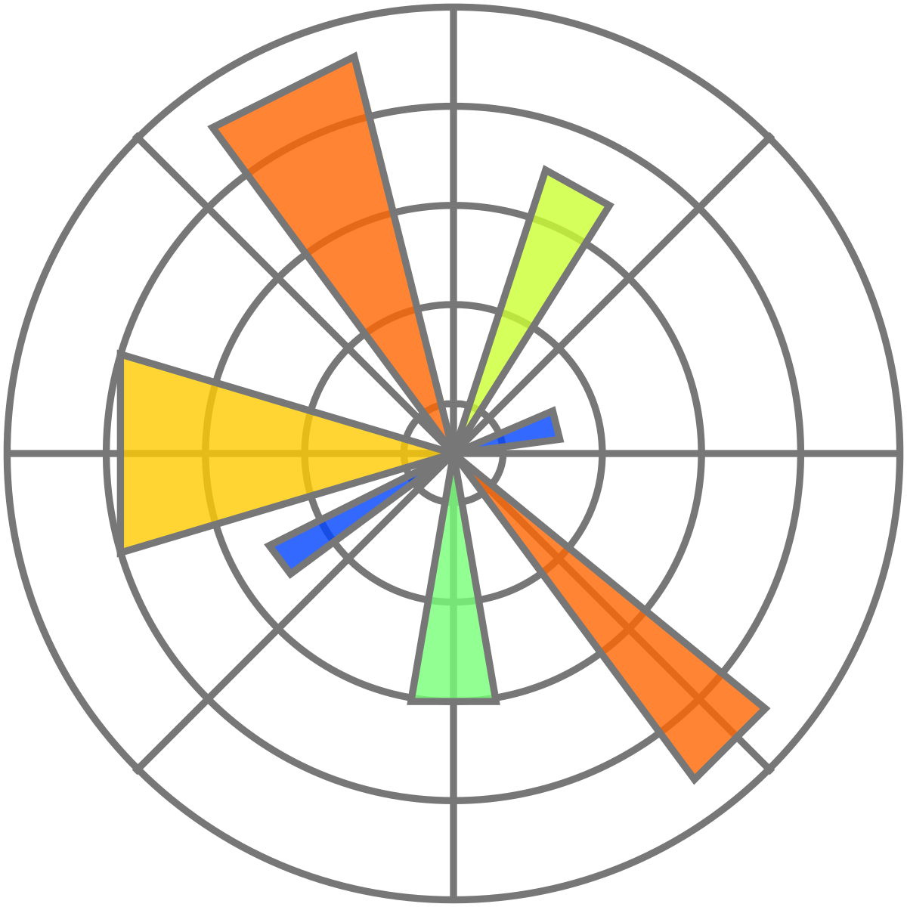
WORKFLOW
EDA
Visualization
SQL & Python
Seaborn & Matplotlib
Data
Modeling
BitcoinHeist Data Set
~3M Transactions & 9 Features
Scikit-learn & Keras

Slide 5
Model Selection
N
LR
RF
NN
Naive Classifier
Logistic Regression
Random Forest
Neural Network
Baseline model with 50% chance of either class
Binary linear decision boundary model
Ensemble learning method for classification
Deep learning algorithms in a node structure

Slide 6
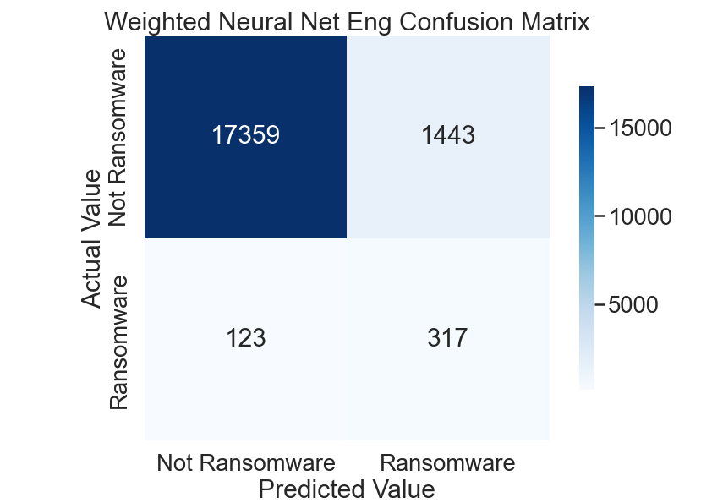
Weighted Neural Network + Feature Eng
Metric | Score
Accuracy | .831
F2 Score | .359
Precision | .107
Recall | .865
ROCAUC | .935

Slide 7
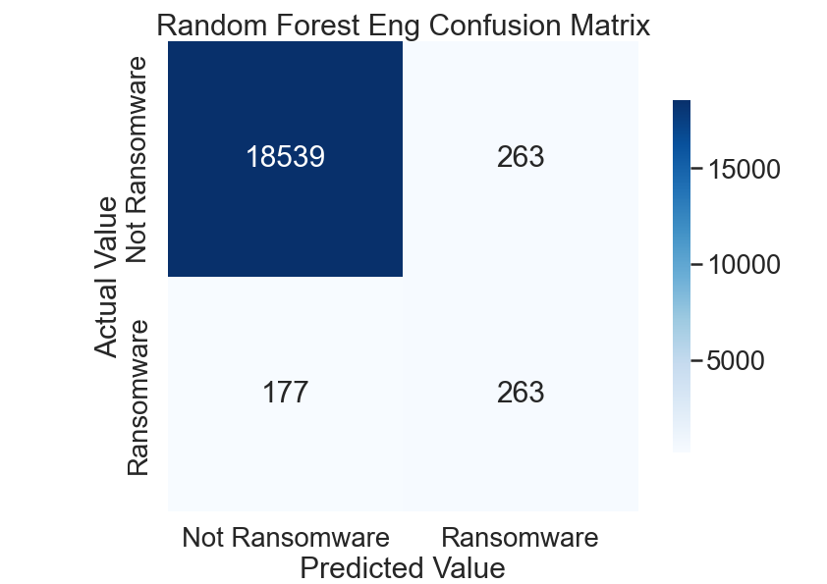
Random Forest + Feature Eng
Metric | Score
Accuracy | .977
F2 Score | .575
Precision | .500
Recall | .598
ROCAUC | .931

Slide 8

Looking Ahead
Modeling ransomware attacks for future Bitcoin transactions could help identify more criminal activity

Slide 9
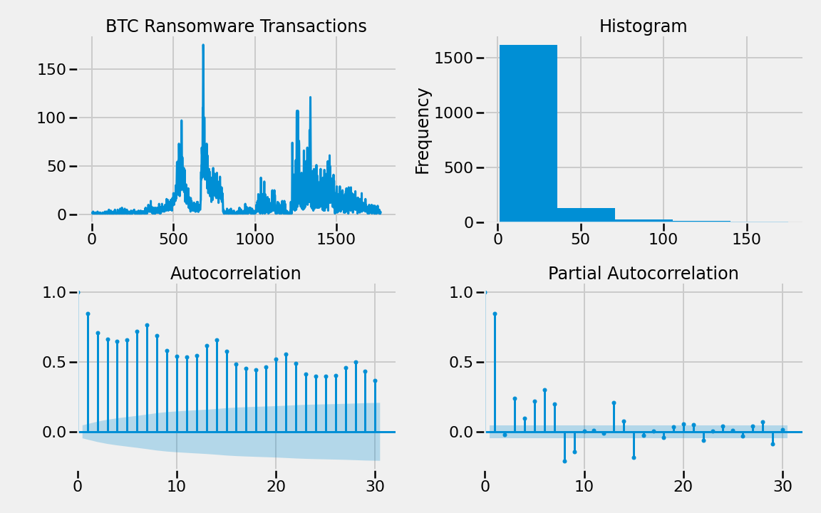
Time-Series Modeling - LSTM

Slide 10
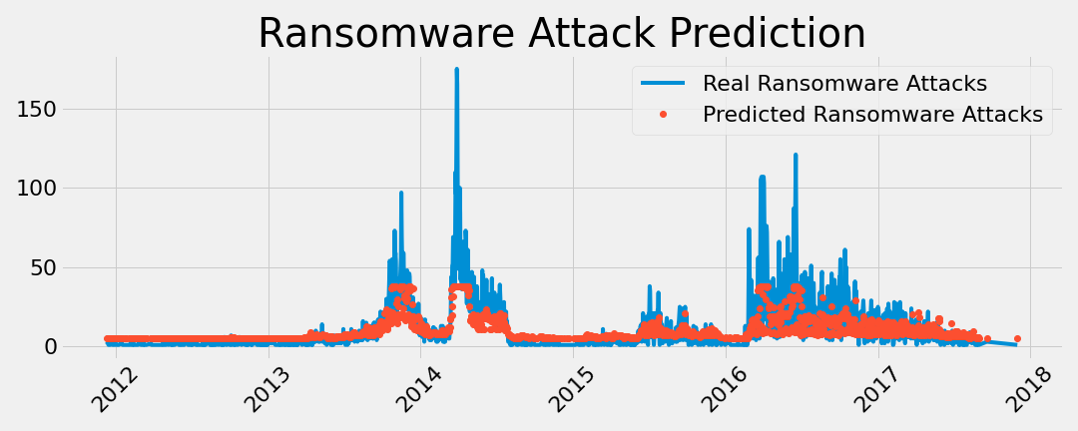
Time-Series Modeling - LSTM
MSE | RMSE | MAE | MAPE | MSLE
0.769 | 0.877 | 0.384 | 238.237 | 0.087

Slide 11
Conclusions
13
24
Timing is everything
Best Predictor
When the transaction occurred was the most important feature
A Random Forest model was the best at identifying Ransomware addresses
Decentralized
Regulation
This type of solution is not against BTC’s core principals of decentralization
As BTC goes mainstream this can help appease regulators

Slide 12
Future Work
Run on a GPU
Utilize the full data set to train neural network models better
Build out model to make future predictions
Get current pricing data to improve ransomeware transactions forecast
Combine both models
Combine the time-series and the classification models to improve performance

Slide 13


